Slide 1
Active Directory Fundamentals Section 2 - Authentication Mechanisms

Slide 2
Agenda
01
05
A bit of LSASS A quick introduction to LSASS in the context of Active Directory authentication.
A hint of account lockout The built-in protection against password discovery attacks.
02
06
A slice of NTLM A close look at this challenge/response mechanism in Windows.
And a Hello for the end The new strong way to authenticate without a password. Say hello to Windows Hello, say good bye to Passwords…
03
A big chunk of Kerberos A detailed description of this MIT authentication protocol used in Windows since Windows 2000.
04
A dash of cached credentials A reminder that you don’t always need a domain controller to sign in.

Slide 3
LSASS and its friends
Windows’ security brain is LSASS
Local Security Authority Subsystem Service
It stores sensitive information
It stores keys and other derived secrets
We need them to ensure SSO
It provides a way to authenticate users
Authenticates and logs users
Call authentication packages
LSASS
This makes Single Sign-On possible
Notes:
This section will not describe Windows security internals as this cursus focuses on Active Directory. However, it is important to know that all authentication related things in Windows have to deal with LSASS.
The Local Security Authority (LSA) is a protected subsystem that maintains the information about all aspects of local security on a system (collectively known as the local security policy and provides various services for translation between names and identifiers.
In general, the LSA performs the following functions:
Manages local security policy.
Provides interactive user authentication services.
Generates tokens, which contain user and group information as well as information about the security privileges for that user. After the initial logon process is complete, all users are identified by their security identifier (SID) and the associated access tokens.
Manages the Audit policy and settings. When an audit alert is generated by the Security Reference Monitor, the LSA is charged with writing that alert to the appropriate system log.
The local security policy identifies the following:
The domains that are trusted to authenticate logon attempts.
Who can have access to the system and in what way (for example, interactively, over the network, or as a service).
Who is assigned privileges.
What security auditing is to be performed.
Default memory quotas (paged and nonpaged memory pool usage).
Note that the secrets are not “really” in clear text in LSASS memory. They are encrypted. But the symmetric key is also stored in… LSASS memory. So one can decrypt the secret just by calling the right functions with the right key (see this reference for authentication function LsaUnprotectMemory https://msdn.microsoft.com/en-us/library/windows/desktop/aa374736(v=vs.85).aspx).

Slide 4
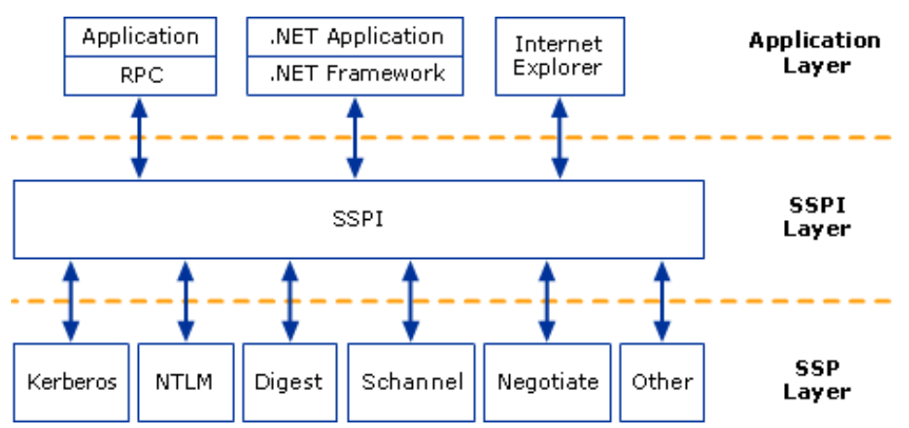
Security Support Providers
Security Support Providers Interface
It is Windows implementation of the Generic Security Service API (GSSAPI)
Security Support Providers are protocol implementations
They have their own DLLs
SPNego is a special
Negotiate is a SSP that acts as an application layer between the SSPI and the other SSPs
It actually calls Kerberos first and falls back to NTLM if Kerberos cannot be used
SSPI
SSP
Notes:
Applications interact with the authentication protocol via the SSPI layer.
Security Support Provider DLLs per protocol:
Msv1_0.dll - The NTLM authentication protocol. This protocol authenticates clients that do not use Kerberos authentication.
Kerberos.dll - The Kerberos V5 authentication protocol. This protocol provides authentication using Kerberos protocol instead of plaintext, NTLM, or digest method.
Wdigest.dll - Simple challenge-and-response protocol that provides increased security over basic authentication.
A common reason for NTLM fall back when using the SPNego SP is the absence of SPN. Kerberos will be tried first but because the SPN cannot be found (or can be found but multiple times in the forest) the client falls back to NTLM.
For more information about GSSAPI, see RFCs 2743 and 2744.
Negotiate implements RFC 2478, “The Simple and Protected GSS-API Negotiation Mechanism.”

Slide 5
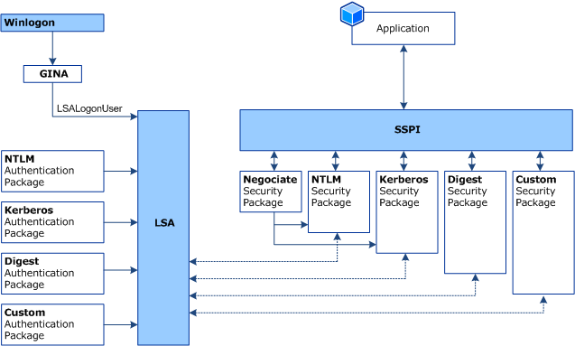
Security Support Provider Selection
CredProv
Notes:
Security Support Provider Selection
Before authentication can take place, the two communicating computers must agree on a protocol that they both can support. For any protocol to be usable through the SSPI, each party must have the appropriate SSP.
The selection of an authentication protocol can be handled in one of two ways, each of which is described in more detail below:
A single authentication protocol can be specified.
The negotiate option can be used to allow the parties to attempt to find an acceptable protocol. This is based on the Simple and Protected GSS-API Negotiation Mechanism (SPNEGO, RFC 2478).
Single Authentication Protocol Specified
When a single acceptable protocol is specified, the server allows only one acceptable authentication method for the exchange. If the client does not support the protocol specified, the communication fails. When a single acceptable protocol is specified, the authentication exchange takes place as follows:
1.The client requests access to a service.
2.The server replies with an authentication challenge in which it specifies the protocol that be used.
3.The client examines the contents of the reply and checks to determine whether it supports the specified protocol. If the client does support the specified protocol, the authentication continues. If the client does not support the protocol, the authentication fails, regardless of whether the client is authorized to access the resource.
Negotiate Option Is Used
When the authentication begins with the option to negotiate for an authentication protocol, the SPNEGO exchange takes place as follows:
1.The client requests access to a service.
2.The server replies with a list of authentication protocols that it can support and an authentication challenge based on the protocol that is its first choice. For example, the server might list Kerberos and NTLM, and send a Kerberos challenge.
3.The client examines the contents of the reply and checks to determine whether it supports any of the specified protocols.
• If the client supports the preferred protocol, authentication proceeds.
• If the client does not support the preferred protocol, but does support one of the other protocols listed by the server, the client lets the server know which authentication protocol it supports, and the authentication proceeds.
• If the client does not support any of the listed protocols, the authentication exchange fails.

Slide 6
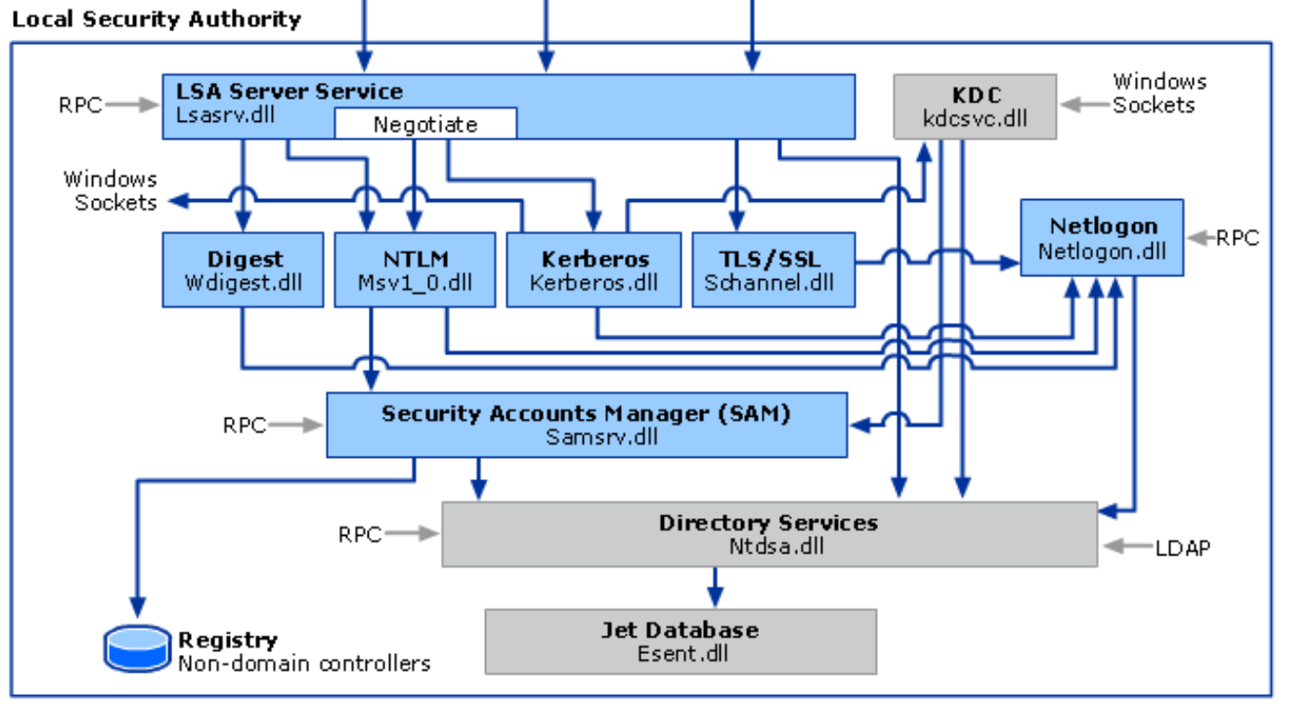
LSASS/SSPI architecture
Notes:
The architecture is actually different with the Isolated Local Security Authority and credential guard. But this is a Windows subject more than an AD one. Besides, Credential Guard is not supported on domain controllers.
Note that LSASS interfaces with the Directory Services as well as the SAM database for local accounts (in case of domain joined machines).

Slide 7
Logon Type and User Right Assignments
Not all logons are born equal
Depending on the type of logon, credentials will be cached on the system
You can restrict the type of logon using group policies and the user right assignment section
Access this Computer from the Network
Log on as a batch job
Log on locally
Log on via Terminal Service
Log on as a service
Deny Access to this computer from the network
Deny local logon
Deny logon as a batch file
Deny logon as a service
Deny logon via Terminal Services
Notes:
The administrator of a system can restrict the type of logons to specific security principals.
Here is the list user right assignment that can be configured in Windows.
Access this Computer from the Network (SeNetworkLogonRight)
Determines which users are allowed to connect over the network to the computer.
Log on as a batch job (SeBatchLogonRight)
Allows a user to log on by using a batch-queue facility.
Log on locally (SeInteractiveLogonRight)
Allows a user to log on locally at the computers keyboard.
Log on via Terminal Service (SeRemoteInteractiveLogonRight)
Logon as a service (SeServiceLogonRight)
Allows a security principal to log on as a service. Services can be configured to run under the LocalSystem account, which has a built-in right to log on as a service. Any service that runs under a separate account must be assigned the right.
Deny Access to this computer from the network (SeDenyNetworkLogonRight)
Prohibits a user or group from connecting to the computer from the network.
Deny local logon (SeDenyInteractiveLogonRight)
Prohibits a user or group from logging on locally at the keyboard.
Deny logon as a batch file (SeDenyBatchLogonRight)
Prohibits a user or group from logging on through a batch-queue facility.
Deny logon as a service (SeDenyServiceLogonRight)
Prohibits a user or group from logging on as a service.
Deny logon via Terminal Services (SeDenyRemoteInteractiveLogonRight)

Slide 8
Logon Type Codes
Logon Type | Name
0 | System
2 | Interactive
3 | Network
4 | Batch
5 | Service
6 | Proxy
7 | Unlock
8 | NetworkCleartext
9 | NewCredentials
10 | RemoteInteractive
11 | CachedInteractive
12 | CachedRemoteInteractive
13 | CachedUnlock
Notes:
Here is a list of the different logon types:
Interactive
The security principal is logging on interactively.
Network
The security principal is logging using a network.
Batch
The logon is for a batch process.
Service
The logon is for a service account.
Proxy
Not supported.
Unlock
The logon is an attempt to unlock a workstation.
NetworkCleartext
The logon is a network logon with plaintext credentials.
NewCredentials
Allows the caller to clone its current token and specify new credentials for outbound connections. The new logon session has the same local identity but uses different credentials for other network connections.
RemoteInteractive
A terminal server session that is both remote and interactive.
CachedInteractive
Attempt to use the cached credentials without going out across the network.
CachedRemoteInteractive
Same as RemoteInteractive, except used internally for auditing purposes.
CachedUnlock
The logon is an attempt to unlock a workstation.
The logon type shows up on the security events 4624 and 4625. Those two events will be covered in the module 2 section 4.

Slide 9
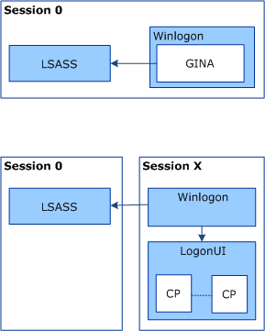
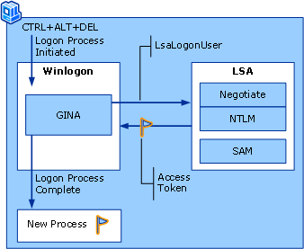
Interactive Logon
Windows 2000/2003/XP
After…
Notes:
When a user opens an interactive session (either because the user is physically in front of the machine or remotely opens a remote desktop session), the system components handling the authentication have changed with the different versions of Windows.
With Windows 2000/2003/XP there was a component called GINA whose role was to offer a mean for the user to enter its credentials. If hacked, it could also offer a perfect way for attackers to collect credentials…
Starting Windows Vista/2008, GINA has been replace with LogonUI. LogonUI is extensible and can call different Credential Providers. The default one is U/P (username and password), but there are others (such as smartcard logon) and it is also extensible so you can develop your own method for login (some multi factor software companies provide their own Credentials Provider). An attacker could also write a Credential provider which looks identical to the default one but that also steals credentials while they are typed… More info about this type of attack here: https://blog.leetsys.com/2012/01/02/capturing-windows-7-credentials-at-logon-using-custom-credential-provider/.
Interactive logon is using the Kerberos authentication protocol in a domain environment. NTLM is used in a workgroup environment.

Slide 10
Logon Time and other artifacts
When a user/computer successfully authenticates it updates the lastLogon attribute
It contains an NT epoch of the time the authentication took place
It is not replicated, so the value is different depending on the DC you query
It also updates another attribute called lastLogonTimeStamp
Which is also a NT epoch
It is replicated!
But it is updated only if the last time it has changed was more than 14 days ago
Notes:
NT epoch is a timestamp expressing how many (10^-7)s intervals between now and the first of January 1601.
lastLogonTimeStamp can be useful to determine if an account is still in use or is stale. But it cannot be used to accurately track when a user was used for the last time because of its update logic. All you need to know about this attribute is here: https://blogs.technet.microsoft.com/askds/2009/04/15/the-lastlogontimestamp-attribute-what-it-was-designed-for-and-how-it-works/

Slide 11
Professor Useful
Last Interactive Logon Timestamp
Feature and attribute available with Windows Server 2008
It stores for each user:
The total number of failed logon attempts at a domain-joined Windows Server 2008 server or a Windows Vista workstation
The total number of failed logon attempts after a successful logon to a Windows Server 2008 server or a Windows Vista workstation
The time of the last failed logon attempt at a Windows Server 2008 or a Windows Vista workstation
The time of the last successful logon attempt at a Windows Server 2008 server or a Windows Vista workstation
Name is misleading, logon as a batch and logon as a service will also update the timestamp
Can prevent users from signing in if deployed the wrong way
Notes:
Last interactive logon information is stored in four attributes of the user objects that are added to the schema when a domain operates at a Windows Server 2008 functional level:
•msDS-FailedInteractiveLogonCount—The number of failed logon attempts at a Windows Server 2008 server or a Windows Vista workstation since the last interactive logon feature was enabled
•msDS-FailedInteractiveLogonCountAtLastSuccessfulLogon—The total number of failed interactive logons up until the last successful Ctrl-Alt-Del logon
•msDS-LastFailedInteractiveLogonTime—A time stamp of the last failed logon attempt
•msDS-LastSuccessfulInteractiveLogonTime—A time stamp of the last successful logon attempt at a Windows Server 2008 server or a Windows Vista workstation
WARNING: If you enable last interactive logon on domain-joined computers that run Windows Server 2008 and Windows Vista or later and you do not enable this feature in a GPO with domain controllers in its scope, users will not able to log on to the system.
Ref: https://docs.microsoft.com/en-us/previous-versions/windows/it-pro/windows-server-2008-R2-and-2008/dd446680(v=ws.10)

Slide 12
New Technology Lan Manager
Different versions
LM, NTLMv1 and NTLMv2
Versions are enabled as per system configurations (client and server settings)
NTLMv2 should be the preferred version of the Windows ecosystem
Embedded protocol
Resource based authentication protocol
Challenge/Response protocol
The resource challenges the user to prove it knowns a shared secret key without sending it
Notes:
The NTLM protocols are embedded protocols. The underlying application protocol semantics determine how and when the NTLM messages are encoded, framed, and transported from the client to the server and vice versa. Because of this, it does not have transport dependencies of its own. So it does not have a network port for example.

Slide 13

NTLM basic flow (SMB example in a workgroup setting)
User
Alice
Server
File1
Provides credentials
Knows
Alice
SAM
Stores Alice’s password hash
Notes:
In this very first example, the scenario is as simple as possible. We take a user trying to access a file hosted on a file server on a workgroup environment. In this case, there is no interaction with a domain controller.
Note that the hash of a password is not reversible.

Slide 14

NTLM basic flow (SMB example)
1. SMB stuff… ‘til…they need authentication
SAM
2. NTLM_NEGOTIATE
3. NTLM_CHALLENGE
4. NTLM_RESPONSE
5. SMB stuff continues…
Notes:
This is the basic flow.
1. Application-specific protocol messages are sent between client and server.
2. The NTLM protocol begins when the application requires an authenticated session. The client sends an NTLM NEGOTIATE_MESSAGE message to the server. This message specifies the desired security features of the session.
3. The server sends an NTLM CHALLENGE_MESSAGE message to the client. The message includes agreed upon security features, and a nonce that the server generates.
4. The client sends an NTLM AUTHENTICATE_MESSAGE message to the server. The message contains the name of a user and a response that proves that the client has the user's password. The server validates the response sent by the client. 5. If the challenge and the response prove that the client has the user's password, the authentication succeeds and the application protocol continues according to its specification. If the authentication fails, the server might send the status in an application protocol–specified way, or it might simply terminate the connection.
Note that because this is an embedded protocol, all this exchange was performed within the SMB session.
The next slides will look in details at the details of each of the 3 NTML messages.

Slide 15
NTLM_NEGOTIATE
The NEGOTIATE_MESSAGE defines an NTLM Negotiate message that is sent from the client to the server. This message allows the client to specify its supported NTLM options to the server.
The registry value LMCompatibilityLevel controls what version of the protocol is available
It defines the behavior of the SP when it is called as a client and as a server
Notes:
The registry values HKEY_LOCAL_MACHINE\SYSTEM\CurrentControlSet\Control\Lsa\MSV1_0\NtlmMinServerSec and HKEY_LOCAL_MACHINE\SYSTEM\CurrentControlSet\Control\Lsa\MSV1_0\NtlmMinClientSec control what are the option available for the NTLM SSP. So applications calling the SSPI have to comply with the requirement specified in these key to go further with the utilization of NTLM on the system. See here for additional information: https://technet.microsoft.com/en-us/library/dd277307.aspx.

Slide 16
LmCompatibilityLevel
HKLM\SYSTEM\CurrentControlSet\Control\Lsa\LmCompatibilityLevel
Level | Sends | Accepts | Prohibits Sending
0 | LM, NTLM | LM, NTLM, NTLMv2 | NTLMv2, Session security
1 | LM, NTLM, Session security | LM, NTLM, NTLMv2 | NTLMv2
2 | NTLM, Session security | LM, NTLM, NTLMv2 | LM and NTLMv2
3 | NTLMv2, Session security | LM, NTLM, NTLMv2 | LM and NTLM
Server Client
Level | Sends | Accepts | Prohibits Accepting
4 | NTLMv2, Session security | NTLM, NTLMv2 | LM
5 | NTLMv2, Session security | NTLMv2 | LM and NTLM
Notes:
NTLM v2 session security is a misnomer because it is not NTLM v2. It is NTLM v1 using the extended session security that is also in NTLM v2.
Additional readings:
LMCompatibilityLevel http://technet.microsoft.com/en-us/library/cc960646.aspx
LMCompatibilityLevel and Its Effects http://support.microsoft.com/kb/175641
The Most Misunderstood Windows Security Setting of All Time http://technet.microsoft.com/en-ca/magazine/2006.08.securitywatch.aspx

Slide 17
NTLMv2 Support
Product | NTLMv1 support | NTLMv2 support
Windows NT 4 | RTM (1996) | Service Pack 4 (25 October 1998)
Windows 95 | Not supported | Directory services client (17 February 2000)
Windows 98 | RTM | Directory services client
Windows 2000 | RTM (17 February 2000) | RTM (17 February 2000)
Windows ME | RTM (14 September 2000) | Directory services client
Samba | ? | Version 3.0 (24 September 2003)
JCIFS | Not supported | Version 1.3.0 (25 October 2008)
IBM AIX (SMBFS) | 5.3 (2004) | Not supported as of v7.1
Notes:
Although all version of Windows support NTLMv2, it is possible to find applications hardcoded to use NTLMv1. Therefore, you need to consider the applications and not the operating systems if you want to disable NTLMv1.

Slide 18
NTLM_CHALLENGE
The CHALLENGE_MESSAGE defines an NTLM challenge message that is sent from the server to the client. The CHALLENGE_MESSAGE is used by the server to challenge the client to prove its identity.
It’s just a 64-bits nonce
Notes:
Must be non predictable and used only once.

Slide 19
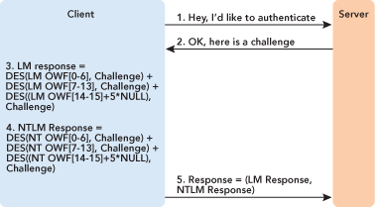
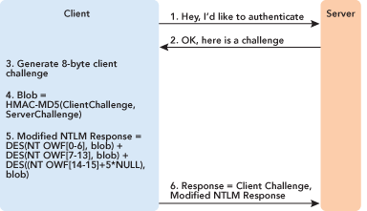
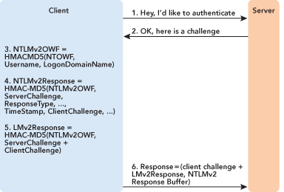
NTLM_RESPONSE
The NTLM_RESPONSE contains the AUTHENTICATE_MESSAGE generated but the client. Its content differs depending of the negotiated version of NTLM.
LM / NTLMv1
NTLMv1 (session security)
NTLMv2

Slide 20
Hash generation
User’s password: Password1
LMHash
NTHash
LMHash (LM OWF)
NTHash (NT OWF)
Password1
Password1
PASSWOR + D1
md4
DES
DES
E52CAC67419A9A22 + 38F10713B629B565
64F12CDDAA88057E06A81B54E73B949B
E52CAC67419A9A2238F10713B629B565
Notes:
When the client receives a challenge, it will use either the LMHash or the NTHash depending on the version of NTLM it picked.
The LMHash (LM One Way Function), also known as the Lan Manager hash, is technically speaking not a hash at all. It is computed as follows:
Convert all lower case characters in the password to upper case
Pad the password with NULL characters until it is exactly 14 characters long
Split the password into two 7 character chunks
Use each chunk separately as a DES key to encrypt a specific string
Concatenate the two cipher texts into a 128-bit string and store the result
As a result, just looking at the LMhash enables you to determine if the password is less than 8 characters, the second part of the hash will be AAD3B435B51404EE. Also, you cannot use password with more than 14 characters. And because it is converting all character to upper case, Password1 has the same hash as PAssWoRd1 and password1.
The NTHash (NT One Way Function) is also known as the Unicode hash, because it supports the full Unicode character set. The NTHash is calculated by simply taking the plaintext password and generating an MD4 hash of it. The MD4 hash is then stored. The NTHash is much more resistant to brute force attacks than the LMHash. Brute forcing an NTHash takes several orders of magnitude longer than brute forcing the LMHash of the same password.

Slide 21

NTLM domain flow (SMB example in a AD domain joined setting)
User
Alice
Knows
Alice
Server
File1
Domain Controller
DC1
Stores Alice password’s hash
NTDS
Notes:
This is NTLM in real life ☺ This is how it works when the user is a domain user and the resource (here File1) is a domain joined computer.

Slide 22

NTLM basic flow (SMB example)
SMB stuff…
NTDS
hashed password
NTLM_NEGOTIATE
challenge
NTLM_CHALLENGE
Response
NTLM_RESPONSE
Passthrough the DC
User + Challenge + Response
SMB stuff continues…
Notes:
In this scenario, File1 does not know the user and forwards the NTLM_AUTHENTICATE message to its local domain controller.
The passthrough message contains the user’s information, the challenge and calculated response.
Note: the NT hash is never sent.

Slide 23
Once upon a time…
LM and NTLM have been around for ever…
Historically, LM was there for LAN Manager and OS-2
But you can still use it now
The LM hash storage is disabled by default since Windows Server 2008
It is a registry/group policy setting
If a password has been set before disabling its storage, the LM hash is still present in the NTDS.dit database
Notes:
How to disable LM storage: Network security: Do not store LAN Manager hash value on next password change https://docs.microsoft.com/en-us/windows/security/threat-protection/security-policy-settings/network-security-do-not-store-lan-manager-hash-value-on-next-password-change

Slide 24
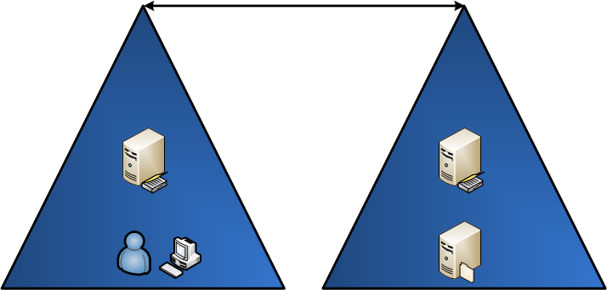

NTLM over trust
contoso.com
fabrikam.com
4
3
2
5
1
6
Notes:
1. The user receives a challenge and sends the calculated response to the server
2. The server forward the user’s information, the challenge and the response to its local domain controller
3. The local domain controller looks up the trust lists and sends user’s information, the challenge and the response to a domain controller in the trusted domain (the domain of the user)
4. The trusted DC answers back to the DC of the server
5. The DC of the server answers back to the server
6. The server accepts or rejects the authentication request

Slide 25
Hash storage in Windows
LSASS stores the user’s hash in memory
Users with the debug privilege can access the memory
There are ways to limit what is going to be cached
Credential Guard (see the Windows Security course)
Notes:
In the case of Credentials Guard, it is Isolated Local Security Authority

Slide 26
Hash storage in Active Directory
Secrets are stored in attributes in the database
These attributes are not readable
LMHash: dBCSPwd
LMHash history: lmPwdHistory
NTHash: unicodePwd
NTHash history: ntPwdHistory
The only way to get a copy of them is to be allowed to replicate the database
Or to access a backup of the NTDS.dit file
Notes:
We are dealing with AD storage here. Because LM and NTLM can also be used in a workgroup environment, the hash can also be stored in the SAM database of a Windows system.
We will discuss attacks against the NTDS.dit database in another module.

Slide 27



Performance issues
NTLM passthrough leverages the secure channel
How many operations can the secure channel handle at a time?
MaxConcurrentApi = 1
MaxConcurrentApi = 2
MaxConcurrentApi = 1
Secure channel
Notes:
HKLM\SYSTEM\CurrentControlSet\Services\Netlogon\Parameters
Value Name: MaxConcurrentApi
Data Type: REG_DWORD
Value: between 0 and 10
To 150 with kb 975363
Monitor with Perfmon Counter:
Semaphore Waiters The number of the thread that is waiting to obtain the semaphore
Semaphore Holders The number of the thread that is holding the semaphore
Semaphore Acquires The total number of times that the semaphore has been obtained over the lifetime of the security channel connection, or since system startup for _Total
Semaphore Timeouts The total number of times that a thread has timed out while it waited for the semaphore over the lifetime of the security channel connection, or since system startup for _Total
Average Semaphore Hold Time The average time (in seconds) that the semaphore is held over the last sample.

Slide 28
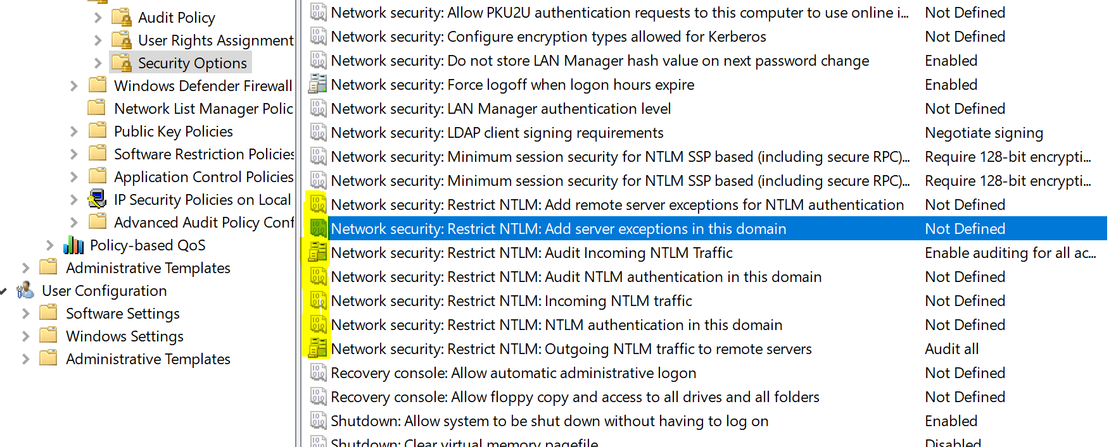
NTLM Blocker
Notes:
NTLM Blocking and You: Application Analysis and Auditing Methodologies in Windows 7 http://blogs.technet.com/b/askds/archive/2009/10/08/ntlm-blocking-and-you-application-analysis-and-auditing-methodologies-in-windows-7.aspx
Introducing the Restriction of NTLM Authentication http://technet.microsoft.com/en-us/library/dd560653(v=WS.10).aspx

Slide 29

Kerberos
Not a Microsoft thing
RFC 4120 for the version 5
Interoperate with Unix/Linux/Java implementation
Resource Network oriented protocol
Ticket based
Valid for 10 hours
3 sub protocols
Authentication Service Exchange
Ticket-Granting Service Exchange
Client/Server Exchange (embedded protocol)
TGS
Notes:
The three sub protocols
Authentication Service Exchange In this subprotocol, the Key Distribution Center (KDC) gives the client a logon session key and a ticket-granting ticket (TGT).
Ticket-Granting Service Exchange In this subprotocol, the KDC distributes a service session key and a ticket for the service.
Client/Server Exchange In this subprotocol, the client presents the ticket for admission to a service.
The Kerberos Network Authentication Service (V5) https://tools.ietf.org/html/rfc4120
Official page for the Kerberos protocol: http://web.mit.edu/kerberos/

Slide 30
Kerberos in a nutshell
A user: Bob
userPrincipalName: bob@contoso.com
UPN
A service: file service on File1
servicePrincipalName: CIFS/file1.contoso.com
SPN
A Key Distribution Center
For a specific realm: contoso.com
KDC
Notes:
Note that there are 3 components like the three heads of the Cerberus.

Slide 31
userPrincipalName
A user: Bob
userPrincipalName: bob@contoso.com
UPN
Looks like an email
The second part is called the UPN suffix, by default it is the DNS name of the domain
Additional and custom UPN suffixes can be added to the forest
Must be unique in the forest
If an account does not have a UPN, an implicit UPN is assumed
Which is the sAMAccountName of the user + the default UPN suffix
Notes:
The UPN is a single value attribute on computer and user objects.
If the UPN is not unique, TGT cannot be asked for the account.

Slide 32
servicePrincipalName
A service: file service on File1
servicePrincipalName: CIFS/file1.contoso.com
SPN
Looks like SERVICECLASS/HOST|FQDN:PORT@REALM
CIFS/file1, HTTP/web.contoso.com, MSSQLSvc/sql1.contoso.com:1433
Must be unique in the forest
If a requested SPN does not exist, the DC tries to find one falling back to the HOST service
If CIFS/file1 is not found, but HOST/file1 exists, the latter will be used for the ticket’s encryption
Notes:
SPN is a multi value attribute on computer and user accounts (case of a service account).
Computer accounts have a default SPN of HOST/FQDN and HOST/HOSTNAME. And additional SPNs can be added to enable Kerberos on specific services.
The port and the trailing realm are optional.
Because the SPN must be unique and is generally registered for both the hostname an the FQDN of a machine, it is not recommended to have machines having the same name in different domains of the same forest.
This mapping can be defined by AD attribute sPNMappings on : CN=Directory Services, CN=Windows NT,CN=Services, CN=Configuration, DC=<Forest Root Domain Component>. Default values are:
sPNMappings: host=alerter,appmgmt,cisvc,clipsrv,dns,browser,dhcp,dnscache,replicator,eventlog,eventsystem,policyagent,oakley,dmserver,mcsvc,fax,msiserver,ias,messenger,netlogon,netman,netdde,netddedsm,nmagent,plugplay,protectedstorage,rasman,rpclocator,rpc,rpcss,remoteaccess,rsvp,samss,scardsvr,scesrv,seclogon,scm,dcom,cifs,spooler,snmp,schedule,tapisrv,trksvr,trkwks,ups,time,wins,www,http,w3svc,iisadmin,msdtc

Slide 33
KDC
A Key Distribution Center
For a specific realm: contoso.com
KDC
It is a Windows service running on all DCs
The KDC secret is the KrbTgt account’s long term key
It is using the tickets
It has two components
Authentication Service (to issue TGTs)
Ticket Granting Service (to issue service tickets)
Notes:
Note that the only time the KrbTgt long term key is changing is when the DFL of a domain is raised from a level lower than 2008 to a level higher than 2008.

Slide 34


Kerberos in a nutshell
1. KRB_AS_REQ
2. KRB_AS_REQ
3. SMB stuff
4. Agreeing on an authentication protocol
5. KRB_TGS_REQ
6. KRB_TGS_REP
7. KRB_AP_REQ
8. KRB_AP_RES
Kerberos traffic
SMB traffic
Notes:
The user is asking for a TGT to the closest domain controller. How does it find it? With the DC Locator mechanism seen in section 1. Generally this happens only once when the user opens a session and the ticket is then valid for 10 hours.
The Ticket Granting Ticket (TGT) is the ticket a user gets when it has successfully proven its identity. Once a TGT has been obtained, the user is no longer required to use its long term key to request for other service tickets.
Note that the very first service ticket a user is asking for while performing an interactive logon is a service ticket for HOST/FQDN of the machine which it is connecting from.

Slide 35
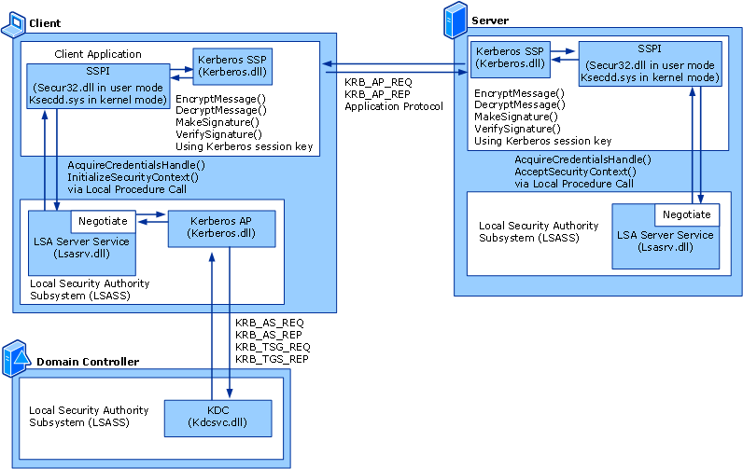
Kerberos in a nutshell (nerd edition)

Slide 36
Kerberos on the wire
Many parts of the messages are in the clear
Of course not the session keys and participants’ secrets!
Error messages are in the clear
Great for troubleshooting!
UDP/TCP port 88
Windows 2000/XP/2003 use UDP first and if it is fragmented, then switch to TCP
Windows Vista/2008 and higher are using TCP right away
Notes:
How to force Kerberos to use TCP instead of UDP (see Kb 244474)
HKEY_LOCAL_MACHINE\System\CurrentControlSet\Control\Lsa\ Kerberos\Parameters\MaxPacketSize
Since Vista, TCP is used by default.

Slide 37

KRB_AS_REQ
1. KRB_AS_REQ
Bob’s secret
KDC-REQ:
cname = bob
realm = contoso.com
sname = krbtgt/contoso.com
eType = ENCTYPE
nonce = 854491316
address = BOBLAPTOP
KDC options = KDC Flags
till = timestamp
PA-DATA:
PA-ENC-TIMESTAMP
PA-PAC-REQUEST
KDC secret
Bob’s secret
Notes:
The first phase is to obtain a TGT.
The user sends information about him:
Basically its UPN
He also specifies what service he wants a ticket for
krbtg/contoso.com
And to prove he knows his long term key (his password) he encrypts a timestamp with his derived password and sends all that over port 88 of a KDC (a domain controller of his domain).

Slide 38
KRB_AS_REP
2. KRB_AS_REQ
Bob’s secret
KDC-REP:
cname = bob
crealm = contoso.com
TGT:
realm = contoso.com
sname = krbtgt/contoso.com
kvno = 3
etype = ETYPE
Key = Session Bob/KDC
PAC = SIDs...
EncKDCRepPart:
kvno = 4
Key = Session Bob/KDC
nonce = 854491316
sreal = contoso.com
sname = krbtgt/contoso.com
caddr = BOBLAPTOP
starttime = timestamp
endtime = timestamp
renew-till = timestamp
flags = Ticket Flags
KDC secret
Bob’s secret
Notes:
The KDC checks if the encryption type is supported. If not, it will send back this error message:
0xE KDC_ERR_ETYPE_NOTSUPP
Then it reads the UPN, checks if there is a UPN like this in its database. If not, before giving up, it will try to build an implicit UPN (so if no user has bob@contoso.com, it will look for user with the sAMAccountName bob in its database).
If there is no match then the answer is:
0x6 KDC_ERR_C_PRINCIPAL_UNKNOWN
If the user is found, the KDC will extract the user’s secret from the database and try to decrypt the PA-ENC-TIMESTAMP structure. If the password is not right, you get this error:
0x18 KDC_ERR_PREAUTH_FAILED
If things look right, the KDC creates a session key. It puts a copy of it on the EncKDCRepPart. The KDC does not keep track of the session key it sends. Therefore, it also puts a copy of the session key in the TGT. The TGT will also contain the PAC (the membership of the user). The KDC encrypts the TGT with the derived password of the KrbTgt account.
Only the KDC can decrypt the TGT. Note that all DCs in the same domain have access to the secret of the KrbTgt account. Hence any DC in the domain can decrypt the TGT. The TGT contains the PAC which contains the list of all SIDs for the user (its user SID and the objectSID of all the groups it belongs to, including nested groups).
Using the long term key for encryption is a risk because an attacker eavesdropping on the network could perform a clear text attack against the KRB_AS_REQ. To avoid this, once a session key is obtained, it is used instead of the long term key of the users.

Slide 39

KRB_TGS_REQ
3. KRB_TGS_REQ
Bob’s secret
TGS-REQ:
realm = contoso.com
sname = cifs/file1.contoso.com
eType = ENCTYPE
nonce = 855037033
KDC options = KDC Flags
till = timestamp
PA-DATA:
PA-TGS-REQUEST:
TGT
Authenticator:
eType = ENCTYPE
cname = bob
crealm = contoso.com
cksum = checksum
ctime = timestamp
seq-number = 855037033
KDC secret
Bob/KDC
Bob’s secret
TGT Bob/KDC
File1 secret
Notes:
The user has now 2 new crypto things in his memory.
The TGT is a black box for the user. He cannot decrypt it. But it is a proof that he was indeed authenticated.
A session key he can use to request tickets from the TGS
So now the user wants a ticket for cifs/file1.contoso.com and he sends his TGT along with an authenticator. The authenticator is encrypted with the session key Bob got during the AS_REP message.
The KDC looks at the SPN. If it does not exist, it will try to map it if the service class is in the sPNMapping attribute. Here it is CIFS, it is in the list. So if cifs/file1.contoso.com does not exist, the KDC will look for host/file1.contoso.com. If none exist, then it sends back an error message:
0x7 KDC_ERR_S_PRINCIPAL_UNKNOWN
Then the KDC opens the TGT and gets the session key. Thanks to that session key, it can decrypt the authenticator.
Note that duplicate SPNs are a fairly common configuration mistake that prevents Kerberos from working as expected. You can actively look for duplicate SPNs with the tool SETSPN.EXE.

Slide 40
KRB_TGS_REP
3. KRB_TGS_REP
Bob’s secret
TGS-REP:
cname = bob
crealm = contoso.com
Service Ticket:
sname = CIFS/file1.contoso.com
realm = contoso.com
kvno = 2
etype = ETYPE
key = Session Bob/File1
PAC = SIDs...
EncTGSRepPart:
kvno = 4
Key = Session Bob/File1
nonce = 854491316
sreal = contoso.com
sname = CIFS/file1.contoso.com
starttime = timestamp
endtime = timestamp
renew-till = timestamp
flags = Ticket Flags
KDC secret
Bob/KDC
Bob’s secret
TGT Bob/KDC
File1 secret
Notes:
The KDC generates another session key and encrypts it with the session key it previously sent to the user.
This session key will enable the user to encrypt traffic between the user and the target service. Because the KDC does not send the key to the service, it puts a copy of that session key in the service ticket and encrypts the service ticket with the derived key of the account holding the SPN.

Slide 41
KRB_AP_REQ
5. KRB_AP_REQ
Bob’s secret
AP-REQ:
ap-options = APOPTIONS
KDC secret
Bob/KDC
Ticket
Authenticator:
eType = ENCTYPE
cname = bob
crealm = contoso.com
cksum = checksum
ctime = timestamp
Bob’s secret
TGT Bob/KDC
File1 secret
Bob/File1
Ticket Bob/File1
40
Notes:
The user has now 2 new crypto things in his memory.
The service ticket for the SPN cifs/file1.contoso.com. Like the TGT, it is a black box for the user. He cannot decrypt it. Only the system knowing the long term secret of the account holding the SPN.
A session key to use between the user and the service
The user now sends its ticket to the service. This is over the application protocol. This is no longer port UDP/TCP:88 on the network, but here it is TCP:445 (SMB protocol).
The default APOPTIONS is asking for mutual authentication (MUTUAL-REQUIRED) which means that the user is asking the service to prove that it was able to read the encrypted ticket (in other words, that the service knows the secret).

Slide 42
KRB_AP_REP
6. KRB_AP_REP
Bob’s secret
AP-REP:
EncAPRepPart:
ctime = timestamp
KDC secret
Bob/KDC
Bob’s secret
TGT Bob/KDC
File1 secret
Bob/File1
Ticket Bob/File1
41
41
Notes:
When the service receives the request, it tries to decrypt the service ticket using its secret. It needs to do this because the ticket contains the session key required to read the rest of the request. If the service cannot decrypt the ticket, it sends the following error message to the user:
0x29 KRB_AP_ERR_MODIFIED
If it can decrypt it, it retrieves the session key and decrypts the authenticator. Then it checks the timestamp. If there is more than a 5 minutes difference between the value and the local clock, the service sends the following error to the client:
0x25 KRB_AP_ERR_SKEW
If things are good, it will create an access token with the data contained in the PAC of the service ticket.
And because the user asked for mutual authentication, the service sends back a timestamp encrypted with the session key (proving that it was able to decrypt the service ticket, hence proving it knows the secret).

Slide 43
KDC and Ticket Flags
Tells the DC what options to enable on the TGT
Can I use delegation?
Is this a delegated ticket already?
Is it ok to renew it?
The KDC will try to accommodate
And reply with BAD_OPTIONS if the options are not compliant with the Kerberos domain policy.
Notes:
Actual structure as per the RFC:
KDCOptions ::= KerberosFlags -- reserved(0), -- forwardable(1), -- forwarded(2), -- proxiable(3), -- proxy(4), -- allow-postdate(5), -- postdated(6), -- unused7(7), -- renewable(8), -- unused9(9), -- unused10(10), Neuman, et al. Standards Track [Page 74] RFC 4120 Kerberos V5 July 2005 -- opt-hardware-auth(11), -- unused12(12), -- unused13(13), -- 15 is reserved for canonicalize -- unused15(15), -- 26 was unused in 1510 -- disable-transited-check(26), -- -- renewable-ok(27), -- enc-tkt-in-skey(28), -- renew(30), -- validate(31)
By default, all AD user tickets are marked as forwardable. It means that any user can be a part of a Kerberos delegation scenario. For Kerberos delegation, see later in this section.

Slide 44
Kerberos Policies
Defined at the domain level
By default, in the Default Domain Policy
Policy setting | Default value
Maximum lifetime for service ticket | 10 hours
Maximum lifetime for user ticket | 10 hours
Maximum lifetime for user ticket renewal | 7 days
Maximum tolerance for computer clock synchronization | 5 minutes
Enforce user logon restrictions | Enabled
Notes:
Kerberos Policy:
Maximum lifetime for service ticket
Determines the maximum amount of time (in minutes) that a ticket granted for a service (that is, a session ticket) can be used to access the service. If the setting is zero minutes, the ticket never expires. Otherwise, the setting must be greater than ten minutes and less than the setting for Maximum lifetime for user ticket. By default, the setting is 600 minutes (10 hours).
Maximum lifetime for user ticket
Determines the maximum amount of time (in hours) that a user’s TGT can be used. When a user’s TGT expires, a new one must be requested or the existing one must be renewed. By default, the setting is ten hours.
Maximum lifetime for user ticket renewal
Determines the longest period of time (in days) that a TGT can be used if it is repeatedly renewed. By default, the setting is seven days.
Maximum tolerance for computer clock synchronization
Determines the maximum difference (in minutes) that Kerberos will tolerate between the time on a client’s clock and the time on a server’s clock while still considering the two clocks synchronous. By default, the setting is five minutes.
Enforce user logon restrictions
Determines whether the KDC validates every request for a session ticket against the user rights policy on the target computer. When this policy is enabled, the user requesting the session ticket must have the right either to Log on locally or to Access this computer from network. Validation of each request is optional because the extra step takes time and might slow network access to services. By default, this policy is enabled.

Slide 45
Encryption negotiation
The KDC can accommodate different encryption types
ETYPE | Name | Default
1 | DES-CBC-CRC | Disabled since Windows Server 2008
3 | DES-CBC-MD5 | Disabled since Windows Server 2008
23 | RC4-HMAC-NT | Enabled
17 | AES128-SHA1 | Enabled (DLF 2008)
18 | AES256-SHA1 | Enabled (DLF 2008)

Slide 46
Encryption probing
To determine what the ETYPE to use is, Windows clients are probing the KDC
They send a KRB_AS_REQ without the PA-ENC-TIMESTAMP
The KDC responds with a KDC_ERROR_PREAUTH_REQUIRED which contains a PA-ENCTYPE-INFO2 block containing the eType to use for the request.
The clients can now request a ticket with the indicated eType
1. KRB_AS_REQ (no PA)
2. PREAUTH_REQUIRED
3. KRB_AS_REQ
4. KRB_AS_REQ
Notes:
If you are capturing network traffic in a Windows environment, you will see a lot of 0x19 KDC_ERR_PREAUTH_REQUIRED error messages. Those are normal, this is the probing used by Windows.

Slide 47
Kerberos long term secret generation
The user’s secret is also known as its long term key
The keys vary depending on the eType
DES and RC4 keys are not salted
AES keys are salted
Keys have version numbers
kvno
It is the version number of the password attribute in AD
Key are stored in the AD object too
The RC4 key is the unicodePwd (same as the NTHash)
The AES keys are stored in the attribute SupplementalCredentials

Slide 48
Professor Useful
NTHash is not salted
Two users with the same password will have the same key
True with Kerberos and RC4 too
AES keys are salted
Two users with the same password will not have the same key
What about iteration count?
AES keys are using a PBKDF2 function called with 4096 iterations
Notes:
The salt used by AES key is the concatenation of the realm in capital letters followed by the samaccountame. For example: Alice in contoso.com, the salt for the AES key will be CONTOSO.COMalice.

Slide 49
Privilege Attribute Certificate
PAC
The PAC contains the authorization information
SIDs
As well as other data about the user (such as profile path, home directory…)
Windows allocates a 48Kb buffer to read the PAC
Windows compresses the SIDs in the PAC
SIDs’ domain parts are redundant
If the PAC does not fit, then the ticket handling fails
Notes:
[MS-PAC]: Privilege Attribute Certificate Data Structure https://msdn.microsoft.com/en-us/library/cc237917.aspx
During the TGS request processing for target service, if the Resource SID-compression-disabled bit is not set in the Application Server's service account’s KerbSupportedEncryptionTypes:
The ResourceGroupDomainSid field contains the SID for the domain.
The ResourceGroupCount field contains the number of groups in the ResourceGroupIds field.
The ResourceGroupIds field contains the pointer to a list of DLG RIDs and their attributes.

Slide 50
Professor Useful
_KERB_VALIDATION_INFO {
LogonTime;
LogoffTime;
PasswordLastSet;
PasswordCanChange;
PasswordMustChange;
EffectiveName;
FullName;
LogonScript;
ProfilePath;
HomeDirectory;
HomeDirectoryDrive;
LogonCount;
BadPasswordCount;
UserId;
PrimaryGroupId;
GroupCount;
GroupIds;
LogonServer;
LogonDomainName;
SidCount;
ResourceGroupDomainSid;
ResourceGroupCount;
ResourceGroupIds;
}
Inside the PAC
(an extract of what’s in it)
Notes:
For the full content and more details about the PAC structure and content, refer to the documentation: http://msdn.microsoft.com/en-us/library/cc237917(v=PROT.10).aspx
Additional resource: http://blogs.msdn.com/b/spatdsg/archive/2009/03/26/more-kerberos-fun-with-pac-s.aspx

Slide 51
Once upon a time…
The MaxTokenSize limit used to be way smaller
8Kb in Windows 2000
12Kb in Windows XP/2003 > Windows 8.1/Windows 2012R2
48Kb since
Although the name is about tokens, the actual registry value is about the allocated size of the buffer
Notes:
For detailed information about the MaxTokenSize, refer to this article: https://blogs.technet.microsoft.com/askds/2012/09/12/maxtokensize-and-windows-8-and-windows-server-2012/

Slide 52
PAC validation
PAC integrity is not always checked against a domain controller
If the consumer of the ticket is not running in the context of local system, network service, or local service then the machine contact its closest DC for PAC validation
This uses the secure channel of the machine
Unless the service’s identity has the SeTCBprivilege privilege
Or if the registry value ValidateKdcPacSignature is set to 1
Notes:
SeTCBprivilege
This policy setting determines whether a process can assume the identity of any user and thereby gain access to the resources that the user is authorized to access. Typically, only low-level authentication services require this user right. Potential access is not limited to what is associated with the user by default. The calling process may request that arbitrary additional privileges be added to the access token. The calling process may also build an access token that does not provide a primary identity for auditing in the system event logs.
ValidateKdcPacSignature
[HKEY_LOCAL_MACHINE\SYSTEM\CurrentControlSet\Control\Lsa\Kerberos\Parameters] Value “ValidateKdcPacSignature”=dword:00000001 When the value of this entry is 0, Kerberos does not perform PAC validation on a process that runs as a service. When the value of this entry is 1, Kerberos performs PAC validation as usual. You have to restart the computer after you modify this registry entry. When this entry is not present, the system behaves as if the entry is present and has a value of 1. The default value in Windows Server 2008 for this entry is 0.
So, because of the PAC validation, there is a dependence between the Kerberos protocol and the Netlogon service (because the Netlogon service manages the secure channel used to check the PAC).

Slide 53
PAC validation dark side
KERB_VERIFY_PAC_REQUEST and its KB friends
Microsoft Security Bulletin MS11-013 – Important An elevation of privilege vulnerability exists in implementations of Kerberos. The vulnerability exists because the Microsoft Kerberos implementation supports a weak hashing mechanism, which can allow for certain aspects of a Kerberos service ticket to be forged. A malicious user or attacker who successfully exploited this vulnerability could obtain a token with elevated privileges on the affected system.
Microsoft Security Bulletin MS14-068 – Critical A remote elevation of privilege vulnerability exists in implementations of Kerberos KDC in Microsoft Windows. The vulnerability exists when the Microsoft Kerberos KDC implementations fail to properly validate signatures, which can allow for certain aspects of a Kerberos service ticket to be forged. Microsoft received information about this vulnerability through coordinated vulnerability disclosure. When this security bulletin was issued, Microsoft was aware of limited, targeted attacks that attempt to exploit this vulnerability.
Notes:
When a PAC need to be checked, the machine is contacting its local domain controller for checksum verification. This call contains a message called KERB_VERIFY_PAC_REQUEST defined in the document [MS-APDS]. On receipt of the message, the DC MUST decode the KERB_VERIFY_PAC_REQUEST message to locate the server checksum and the Key Distribution Center (KDC) checksum values. The DC MUST verify the KDC checksum, which is a keyed hash [RFC4757] over the server checksum passed in the request. If the checksum verification fails, the DC MUST return an error code, STATUS_LOGON_FAILURE (section 2.2) as the return value to the Netlogon Generic Pass-through method. If the checksum is verified, the DC MUST return STATUS_SUCCESS.
See http://adsecurity.org/?p=525 to look at an analysis of the different modifications some KB have done on this verification.
Microsoft Security Bulletin MS11-013 – Important https://docs.microsoft.com/en-us/security-updates/securitybulletins/2011/ms11-013
Microsoft Security Bulletin MS14-068 – Critical https://docs.microsoft.com/en-us/security-updates/securitybulletins/2014/ms14-068

Slide 54
PKINIT based authentication
Uses a certificate to authenticate with the KDC
The KRB_AS_REQ will not be encrypted with the derived user’s long term key but with the private key of the user
Requires that the KDC has a valid certificate
Both user and KDC certificate have to come from a Certification Authority trusted by the forest
It means that the certificate of the CA has to be stored in a particular location in configuration NC
Certificate revocation needs to be possible too
Notes:
The certificate of the Certification Authority which issued the certificate of the user and the certificate of the KDC have to be published in the caCertificate attribute of the CN=NTAuthCertificates,CN=Public Key Services,CN=Services,CN=Configuration,DC=contoso,DC=com object.
Ref: Public Key Cryptography for Initial Authentication (PKINIT) in Kerberos Protocol Specification : http://msdn.microsoft.com/en-us/library/cc238455(v=prot.13).aspx
For the different way to map a certificate to a user in AD, you can refer to this article: https://blogs.msdn.microsoft.com/spatdsg/2010/06/18/howto-map-a-user-to-a-certificate-via-all-the-methods-available-in-the-altsecurityidentities-attribute/

Slide 55
KRB_AS_REQ with PA_PK_AS_REQ
Trusted CA in NTAuth
1. KRB_AS_REQ
Bob’s secret
KDC-REQ:
cname = bob
realm = contoso.com
sname = krbtgt/contoso.com
eType = ENCTYPE
nonce = 854491316
address = BOBLAPTOP
KDC options = KDC Flags
till = timestamp
PA-DATA:
PA_PK_AS_REQ
KDC secret
Bob Public Key
Bob Public Key
Bob’s secret
Bob Private Key
KDC Public Key
KDC Private Key
Notes:
A ticket-granting ticket (TGT) request is sent to the DC. This request contains the following data: User's principal name and a timestamp—both signed using User's private key—and a copy of User's certificate.
PA_PK_AS_REQ is encrypted with Bob’s private key.
Bob also sends his own certificate

Slide 56
KRB_AS_REP with PA_PK_AS_REP
Trusted CA in NTAuth
2. KRB_AS_REQ
Bob’s secret
KDC-REP:
cname = bob
crealm = contoso.com
TGT:
realm = contoso.com
sname = krbtgt/contoso.com
kvno = 3
etype = ETYPE
Key = Session Bob/KDC
PAC = SIDs...
+ NT Hash
EncKDCRepPart:
kvno = 4
Key = Session Bob/KDC
nonce = 854491316
sreal = contoso.com
sname = krbtgt/contoso.com
caddr = BOBLAPTOP
starttime = timestamp
endtime = timestamp
renew-till = timestamp
flags = Ticket Flags
KDC secret
Bob Public Key
Bob’s secret
Bob Private Key
KDC Public Key
KDC Private Key
Notes:
To validate the request and the digital signature, the Key Distribution Center (KDC) first validates User's certificate. The DC then queries AD for a mapping between User's certificate and a Windows user account. If the DC finds a mapping, it generates a new session key and issues a TGT for the corresponding user account. More about cert mapping: https://technet.microsoft.com/en-us/library/92aea8c5-c617-4a04-9356-e0ad8dd4cea9(v=ws.10)#BKMK_ClientCertificateMappings
The DC sends the TGT to User, together with a secured copy of the session key. User's copy of the session key is encrypted using her public key.

Slide 57
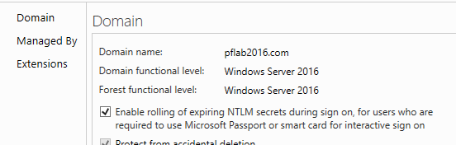
Certificate based authentication
Note that in this situation, the PAC will contain an NTLM_SUPPLEMENTAL_CREDENTIAL structure containing the NTHash of the user
If a user requires a Smartcard for logon, its long term secret never changes
Windows Server 2016 domain controllers introduced an automatic rollover of the user’s secret
Notes:
Why a NTLM_SUPPLEMENTAL_CREDENTIAL section? Because we might need to be able to connect to resources which supports only NTLM. In that case, even if the authentication has never used the user long term key, this enables the system to know what is the NTHash of the user to answer the solicitations from the NTLM SSP.
Background: How NTLM Secrets Roll
Domain User signs into a Windows device with a smart card or Windows Hello
A Kerberos authentication request is made to a 2016 domain controller
If the NTLM secret/user password is set to expire before the user signs in again we roll the secret
The dc provides Kerberos authentication reply and the user goes about their day
Better
NTLM secrets roll if needed when sign on or unlocking Windows
Passwords expire, so stolen NTLM secrets stop working after expiration
Existing AD password policies control password lifetime

Slide 58
Kerberos over trust
You need a TGT to ask for a service ticket
If the service is in another domain (and trusted) your local KDC will give you a TGS referral
It’s like a TGT but for another domain
It is using the derived trust’s secret for encryption
You can use it to request a service ticket in that domain
Kerberos might not work over external trusts
You can configure Forest Search Order to make it happen (either on the clients or on the KDCs)
Notes:
The TGS referral is encrypted with the trust account. It is a account managed by the system for which the password changed on both side of the trust every 30 days.

Slide 59
Kerberos over trust
Kerberos Trust
contoso.com
fabrikam.com
3
2
1
4
5
Notes:
1. Bob requests a TGT for his domain
2. Bob requests a ticket for CIFS/file1.fabrikam.com
3. The KDC found the SPN via a global catalog lookup. Here is a TGT for the realm fabrikam.com (based on the trust’s password).
4. Bon request a ticket for CIFS/file1.fabrikam.com with the TGT for fabrikam.com. The ticket is delivered.
5. Bob presents the ticket to file1

Slide 60
Professor Useful
Kerberos over external trusts
Many Kerberos authentication failures are due to the inability to locate the target service in another forest
Forest Search Order can be used for clients or for KDCs
It is set via GPO
Notes:
Forest Search Order for SPN is to Kerberos what DNS search suffix is to DNS.
If the SPN is not found as-is, the KDC will lookup with specific suffixes.
And if enabled at the client side, the user will request tickets with the different suffixes until it gets one (unless the SPN cannot be resolved with all the attempt and in that case, if the SPNego SSP was used, the client will fall back to NTLM).

Slide 61
Delegation
Delegation (or Kerberos forwarding) offers the ability for a service to impersonate a user against another service
Best suited for n-tiers applications where the front-end application can request a ticket to access the back-end services of the application on behalf of the user
Without prompting the user
Maintaining the context of the identity of the user end-to-end
Only domain administrators can enable delegation on accounts
Privilege: SeEnableDelegationPrivilege
Notes:
More about the privilege: Enable computer and user accounts to be trusted for delegation (SeEnableDelegationPrivilege)
Allows the user to change the Trusted for Delegation setting on a user or computer in Active Directory. The user or computer that is granted this privilege must also have write access to the account control flag on the object.

Slide 62
Delegation Capabilities
Windows Server 2000 introduced un-constrained delegation
Windows Server 2003 introduced constrained delegation and protocol transition with Kerberos extensions S4U and S4U2Proxy
Each middle-tier calling principal and back-end service must be in the same domain.
Domain administrators are responsible for configuration/setup.
A resource owner has no control over which middle-tier service may delegate to it.
Windows Server 2012 introduced constrained delegation at the target resource
Control over which middle-tier services may delegate caller identities to the target resource.
Target service owner control without domain admin requirements.
The middle tier can exist in different trusted realms from a resource tier.

Slide 63
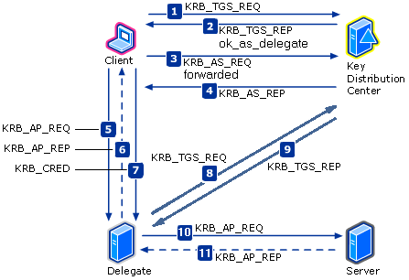
Unconstraint delegation
The user sends its TGT
The FrontEnd service uses it to request a service ticket
The FE can request ANY service ticket
If the FE is compromised, we can access any resources the user has access to
Notes:
Note that the message 7 is not sent if the user’s TGT is marked as forwardable. In fact, the user’s TGT has already been sent in the message 5.

Slide 64
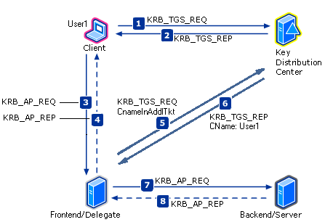
S4U2Proxy
Constraint delegation
The user sends it TGT
The FrontEnd service uses it to request a service ticket
The FE can request only service tickets for defined SPNs
If the FE is compromised, we can access only to resources the user has access to using the specified SPN (attribute: msDS-AllowedToDelegateTo)
Notes:
In order to make this work, the account used for the front-end needs the attribute msDS-AllowedToDelegateTo set with the list of backend SPNs.
Client has already forwardable TGT for the user, requesting a TGS for the target SPN of the Delegate/Front-end.
KDC sends a TGS reply without flag ok_as_delegate , no forwarded TGT is required, a forwardable TGS is sufficient
The client uses the service ticket to connect to the delegate/Front-end server and requests mutual authentication
The client authenticates the delegate/Frontend server
Delegate/Frontend requests TGS for Server/Backend SPN with Cname-In-Addl-Tkt flag set + an AdditionalTickets in ReqBody contains evidence TGS (where the PAC is related to the user1) from step 2
KDC verifies evidence TGS and authenticator, replies with Back-end TGS for the user (Cname: User1) . This occurs only if the requested Back-end SPNs is listed in the A2D2 attribute of the Front-end identity object.
KRB_AP_REQ contains the user's TGS. Authenticator is encrypted with the TGS-supplied Backend/Server session key.
KRB_AP_REP is handled as before with Mutual Authentication check
Ref: http://msdn.microsoft.com/en-us/library/cc246080.aspx

Slide 65
Resource-based constraint delegation
Give the backend service the power
The backend service decides from where it is accepting forwarded tickets
Instead of letting the frontend decide where it is allowed to access
New attribute: msDS-AllowedToActOnBehalfOfOtherIdentity
Requirements
Windows Server 2012 KDC in the Front-end account domain
Windows Server 2012 KDC in the Back-end resource domain
Windows Server 2012 running on the Front-end server
Notes:
It permits back-end to authorize which front-end service-accounts can impersonate users against their resources.
Supported scenarios
Client forest A to services forest B: Supported
Client & Frontend forest A to backend forest B: Supported
Client & Backend forest A to frontend forest B : Not Supported
Client forest A to Frontend Forest B to Backend forest C: Not Supported

Slide 66
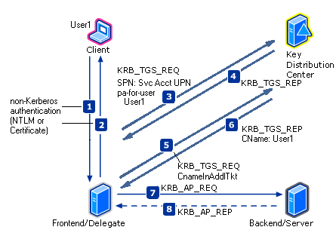
S4U2Proxy + S4U2Self
Constraint delegation with protocol transition
What if the user did not use Kerberos to start with?
Well then we can transition it to Kerberos silently…
It requires the frontend service to have the right delegation flag on its accounts and the appropriate level of privilege on the local system
Notes:
In order to make this work, the account used for the front-end needs the attribute msDS-AllowedToDelegateTo to be set with the list of backend SPNs.
The front-end account also needs the flag TRUSTED_TO_AUTH_FOR_DELEGATION in the userAccountControl attribute.
Non-Kerberos authentication : Client has neither forwardable TGT for the user, nor requesting a TGS for Frontend.
Frontend accepts session retrieving cname and crealm or the users Certificate
Frontend requests TGS to itself (to its own UPN as Sname), with field PA-FOR-USER (cname/crealm) or PA-S4U-X509-USER (Certificate) for the user.
KDC returns a service TGS ticket where the SPN is the Frontend while the PAC is about User1 (similar to evidence ticket in KCD)
Frontend requests TGS for Server/Backend SPN with Cname-In-Addl-Tkt flag set, AdditionalTickets in ReqBody contains evidence TGS from step 4
KDC verifies evidence TGS and authenticator, replies with Backend TGS for the user, Cname: User1
KRB_AP_REQ contains the user's TGS. Authenticator is encrypted with the TGS-supplied Backend/Server session key.
KRB_AP_REP is handled as before with Mutual Authentication check
Ref: http://msdn.microsoft.com/en-us/library/cc246080.aspx

Slide 67
The master of the keys
The hash of the KrbTgt account is the key of all TGTs
The KrbTgt’s long term key never changes
It does only once when changing the DFL to 2008 or higher
Can be manually reset
We will see in the next module what the associated risks and attacks against Kerberos are

Slide 68
Claims
It is possible to add arbitrary claims in the PAC
You can select attributes on the user or machine that will be added into the PAC
This can be used only for file permissions on Windows 8/Windows Server 2012
This is not enabled by default
This has to be supported by the KDC (Windows Server 2012 or higher)
This has to be enabled on the client (Windows 8 or higher)
Can leverage Kerberos protocol transition to allow legacy clients to access files on a server for which the DACLs are using claims

Slide 69
Kerberos armoring
FAST
Flexible Authentication Secure Tunneling
The computer’s TGT is used to protect the AS and TGS user’s exchanges with the KDC
It requires at least Windows 2012 KDC and Windows 8 clients
If you enforce FAST in the domain and have workstations and servers lower than Windows 8/Windows 2012, they will not be able to login anymore
Notes:
Flexible Authentication Secure Tunneling (FAST) provides a protected channel between the Kerberos client and the KDC. FAST is implemented as Kerberos armoring in Windows Server 2012, and it is only available for authentication service (AS) and ticket-granting service (TGS) exchanges.
FAST will be dealt with in module 2 section 3.

Slide 70
keytab
Unix/Linux/Java applications don’t have LSASS to store the long term key
So you can generate a file containing the key
You can use the KTPASS utility to generate keytabs
Treat keytabs like you would treat password, they contains clear text encryption keys!
Notes:
Examples of keytab generation using ktpass can be found here: https://blogs.technet.microsoft.com/pie/2018/01/03/all-you-need-to-know-about-keytab-files/

Slide 71
What time is it?
Because time is very sensitive in a Kerberos realm, we need to be on-time
The Windows Time service (w32tm) maintains the domain joined systems’ local clocks synced with the domain controllers’ clocks
Each DC is a NTP server
The PDC of the root domain is the time reference for the forest
If there are more than 5 minutes time difference between systems, we cannot do Kerberos!
Notes:
All machines in the forest should have the registry value HKEY_LOCAL_MACHINE\SYSTEM\CurrentControlSet\Services\W32Time\Parameter\Type set to NT5DS.
Only the PDC of the root domain of the forest can have it set to NTP.
Ref: Windows Time Service Technical Reference https://docs.microsoft.com/en-us/previous-versions/windows/it-pro/windows-server-2003/cc773061(v=ws.10)

Slide 72
Windows Cached Credentials
Working from home? You can still sign-in in Windows without talking to a domain controller
This is thanks to the cached credentials in Windows
HKEY_LOCAL_MACHINE\SECURITY\Cache
It is salted… With a username…
It is encrypted…
Can be overwritten !
By default, the last 10 users are cached
Can be changed…
Notes:
It is this feature that enables a user to unlock or logon into a computer even if there is no line of sight of a domain controller. In a nutshell, the credentials of the users are salted and encrypted, and stored locally on a registry hive.
Cached credentials never expire. So if a user is deleted from Active Directory, it will still be able to open a local session on its computer as long as it doesn’t communicate with a domain controller. As soon as the domain controller is reachable during a logon attempts, the cache will be unvalidated if the user was disabled or deleted.
When a user logged in using its cached LogonType 11 in the event 4624 of the machine security event logs.
Here are interesting articles explaining how the encryption for cache credentials works and how to overwrite it:
- https://cqureacademy.com/blog/windows-internals/cached-credentials-important-facts
- http://moyix.blogspot.ca/2008/02/cached-domain-credentials.html
Sorry, but now we are out of scope! DPAPI and other cached credentials interesting bits will be covered in the Windows Security cursus.

Slide 73
Account Lockout Policy
Prevents password discovery type of attacks
Creates an opportunity for a DOS type of attack
Account Lockout Settings
LockoutThreshold
LockoutDuration
ObservationWindow
Account Lockout Values
badPwdCount (not replicated)
badPasswordTime (not replicated)
ntPwdHistory (cannot be read) – used for Password history check N-2
Notes:
LockoutThreshold
The LockoutThreshold setting (also known in Group Policy as the Account lockout threshold setting) is the number of times that the user, computer, service, or program can send a bad password during logon authentication before the account is locked out. Account lockout occurs when the badPwdCount registry value is equal to or exceeds the LockoutThreshold value. You can adjust the LockoutThreshold value to prevent both brute force and dictionary attacks, but you can set the value too low to capture user error and other non-attack errors. Administrators often set this value too low (3 through 5), which causes a large number of account lockouts because of user error, program caching by service accounts, or issues with networking clients. If you set the LockoutThreshold value to 0, no account lockouts occur on the domain.
Valid non-zero values are between 1 and 999, with a default value of zero.
LockoutDuration
The LockoutDuration setting (also known in Group Policy as the Account lockout duration setting) is the amount of time, in minutes, that account lockout is enforced on an account that has exceeded the LockoutDuration registry value, measured from the time of lockout. If you set the LockoutDuration registry value to 0, the account is permanently locked out until either an administrator or a user who has a delegated account resets the account. If the administrator or a delegated user account does not unlock the account, the operating system unlocks the account after the number of minutes that you set in the LockoutDuration registry value. Non-zero values for the LockoutDuration registry value reduce the administrative overhead of unlocking accounts by having them unlocked automatically; however, non-zero values do not provide the added security of user validation before the account is restored.
Valid non-zero values are between 1 and 99999, with a default value of 30.
ObservationWindow
The ObservationWindow setting (also known in Group Policy as the Reset account lockout counter after setting) is the number of minutes after which an accounts badPwdCount registry value is reset. You can use the ObservationWindow setting to help mitigate lockout issues that are initiated by users. When you enable this setting, the bad password attempt is removed from the server after a period of time.
Valid non-zero values are between 1 and 99999, with a default value of 30
badPwdCount
The badPwdCount value stores the number of times that the user, computer, or service account tried to log on to the account by using an incorrect password. This value is maintained separately on each domain controller in the domain, except for the PDC operations master of the accounts domain that maintains the total number of incorrect password attempts. A value of 0 indicates that the value is unknown. For an accurate total of the user's incorrect password attempts in the domain, you must query each domain controller and use the sum of the values.
badPasswordTime
The badPasswordTime value stores the last time that the user, computer, or service account submitted a password that did not match the password on the authenticating domain controller This property is stored locally on each domain controller that is in the domain. A value of 0 means that the last incorrect password time is unknown. For an accurate value for the user's last incorrect password time in the domain, you must query each domain controller that is in the domain; the largest one is the accurate value.
ntPwdHistory
The ntPwdHistory registry value contains the password history for the user in Windows NT Server 4.0 one-way function (OWF). Both Windows 2000 and the Windows Server 2003 family use the Windows NT Server 4.0 OWF. This property is used by only the operating system. Note that you cannot obtain the password from the password in OWF form.
Password history check (N-2): Before a Windows Server 2003 operating system increments badPwdCount, it checks the invalid password against the password history. If the password is the same as one of the last two entries that are in the password history, badPwdCount is not incremented for both NTLM and the Kerberos protocol. This change to domain controllers should reduce the number of lockouts that occur because of user error.

Slide 74
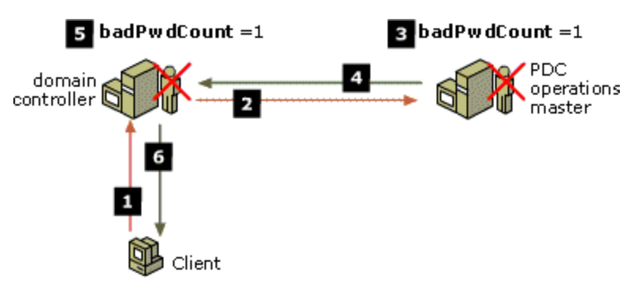
How domain controllers verify passwords
Process for a Failed Logon Attempt
Notes:
1. The client computer presents the user logon information to a domain controller. This includes the users account name and a cryptographic hash of their password. This information can be sent to any domain controller and is typically sent to the domain controller that is identified as the closest domain controller to the client computer.
2. When a domain controller detects that an authentication attempt did not work and a condition of STATUS_WRONG_PASSWORD, STATUS_PASSWORD_EXPIRED, STATUS_PASSWORD_MUST_CHANGE, or STATUS_ACCOUNT_LOCKED_OUT is returned, the domain controller forwards the authentication attempt to the primary domain controller (PDC) emulator operations master. Essentially, the domain controller queries the PDC to authoritatively determine if the password is current. The domain controller queries the PDC for this information because the domain controller may not have the most current password for the user but, by design, the PDC emulator operations master always has the most current password.
3. The authentication request is retried by the PDC emulator operations master to verify that the password is correct. If the PDC emulator operations master rejects the bad password, the PDC emulator operations master increments the badPwdCount attribute for that user object. The PDC is the authority on the user's password validity.
4. The failed logon result information is sent by the PDC emulator operations master to the authenticating domain controller.
5. The authenticating domain controller also increments its copy of the badPwdCount attribute for the user object.
6. The authenticating domain controller then sends a response to the client computer that notifies the domain controller that the logon attempt did not work.

Slide 75
All my users are locked out
You kinda asked for it...
Especially if it is possible to log into an application on the Internet using AD authentication on the backend
The built-in Administrator is your savior!
It is usable even when it is locked out
Wait, now the built-in Administrator is your Achilles’ heel!
You need a strong password for this one and monitor failed authentications
Or you can disable it…
Be ready! And craft a procedure in case of such an event
500
Notes:
External applications (such as webmails) offer a mean for an attacker to try U/P from the internet. This can lead to a massive lockout of users. You need to be ready for this and know what to do.

Slide 76
No passwords anymore…
Windows Hello for Business removes the need of passwords to open a session on a Windows device
The idea is quite simple…
We prove who we are
We capture some biometric data (and a PIN)
We register the device
Next time you logon, just smile at your screen!* * or a PIN if it’s halloween
Notes:
Nobody likes passwords…
Strong passwords can be difficult to remember, and users often reuse passwords on multiple sites
Server breaches can expose passwords
Passwords are subject to replay attacks and target of phishing attacks
Passwords + 2FA is more secure, but inconvenient
SSO while outside of network perimeter is complicated (no line of sight with domain controllers, no universal authentication protocol between on-premises apps and SaaS apps)
Not to mention that password in enterprises in a very expensive topic. Users forgetting their password is also causing major cost in helpdesk.
PIN benefits
Tied to the device – mitigating phishing attacks
Local to the device – mitigating replay (pass the hash) attacks
Backed by hardware TPM - mitigating anti-hammering attacks and private key export
Can be complex or simple

Slide 77
WH vs WH4B
Windows Hello
Biometric Framework provided in windows 10
Targeted toward individual/consumer devices
Enable user to sign into their devices by securely storing their username and password and releasing it for authentication
Windows hello for business
Uses asymmetric keys protected by the device’s security module that requires a user gesture (PIN or Biometric) to authenticate
Need Azure AD or Windows server 2016 Domain controller and ADFS servers
WH4B
Notes:
But Windows Hello for Business (formerly Windows Passport for work) is not Windows Hello (formerly Windows Passport period).
Windows Hello allows individuals to create a PIN or biometric gesture on their personal devices for convenient sign-in. Windows Hello securely stores the username and password and releases it for authentication when the user successfully identifies themselves using biometrics. This use of Hello provides a layer of protection by being unique to the device on which it is set up, however it is not backed by key-based or certificate-based authentication.
Windows Hello for Business uses key-based or certificate-based authentication.
Requirements:
At the enterprise level: the enterprise has an Azure subscription
At the user level: the user's computer runs Windows 10 Professional or Enterprise
The device needs a TPM and the device needs to be enrolled (Azure AD or AD DS via ADFS Device Registration Service)

Slide 78
Virtualization Based Security
Normal
VBS
WBioSrvc
TPM
Biometric Unit
Sensor Driver
BioIso
Sensor
Biometric Unit
Engine
Engine
Storage
Storage
Templates
(Encrypted to BioIso)
Notes:
Hardware based isolation, with Virtualization Based Security (VBS), is one of the key ways we harden against attacks.
Secure execution environment isolated from the high-level OS
Enhanced OS protection against attacks (including attacks from kernel mode)
Protection of secrets (e.g. derived user credentials)
Windows Hello’s biometrics validation components and the user’s biometric data will be moved into this environment to ensure this data remains secure from the most advanced threats.

Slide 79
How does it work on the network?
It is Kerberos authentication, using the PKINIT extension
Like for certificate based authentication
But it does not require to deploy a certificate on the client
There are two trust models
The certificate one (this one will require some certificate on the client, deployment of such a certificate will be managed by an intermediary)
The key model (no certificate on the client but still using the PKINIT extension of Kerberos, this requires Windows Server 2016 domain controllers)
This is a Windows 10 thing
Notes:
The trust model is a design decision you have to make when you deploy WH4B.
This is working with Windows 10 devices (Enterprise and Pro version).

Slide 80
Deployment model
Cloud only deployment
Everything is managed in Azure
Hybrid deployment
Provisioning is in Azure
Public keys are written back on-premises
On-premises deployments
Everything is taking place on-premises
Notes:
Those are also design decisions to make before deploying WH4B.
For the on-premises version, the MFA can actually be performed in Azure but the device provisioning will be on-premises (handled by ADFS DRS).
Ref: https://aka.ms/whfbdocs
Ref: https://aka.ms/whfbplan
Ref: https://aka.ms/whfbdeploy

Slide 81
Deployment steps
First register the device
Using ADFS Device Registration Service
Or using Azure AD
The user will have to perform a strong authentication to enroll the device
Second, authenticate
This will use the same flow as the Kerberos PKInit seen previously in this course
Notes:
If this is an Hybrid environment, you can also get a Primary Refresh Token for Azure AD SSO, but that’s for module 4!
Ref: https://docs.microsoft.com/en-us/windows/security/identity-protection/hello-for-business/hello-how-it-works

Slide 82
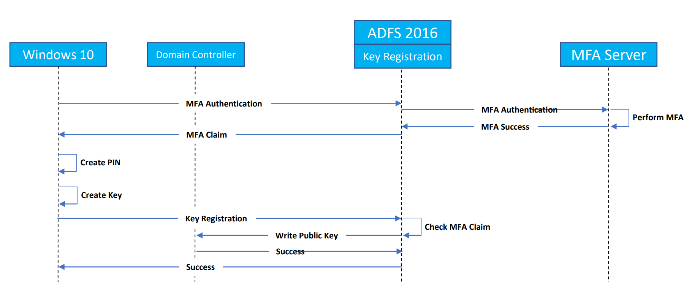
Provisioning flow with key trust
Notes:
Flow for provisioning with key trust model.
This requires Windows Server 2016 domain controllers.

Slide 83
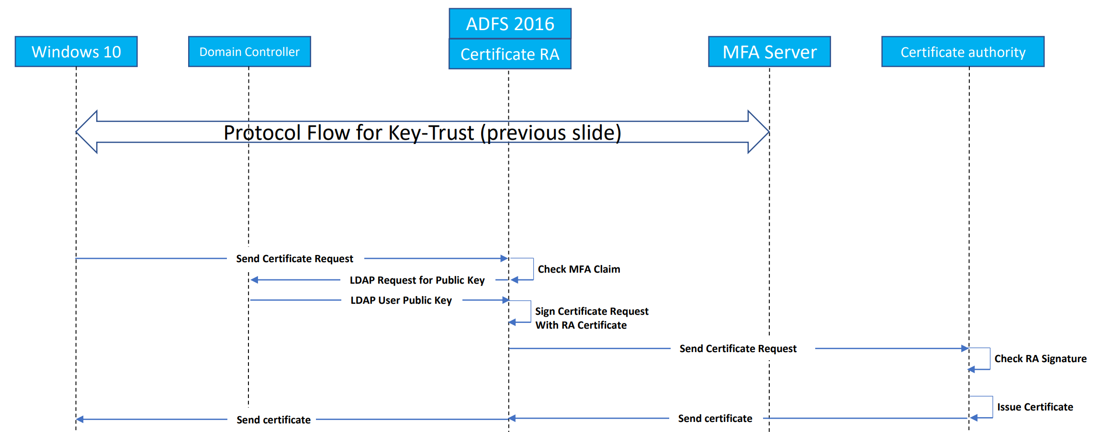
Provisioning flow with certificate trust
Notes:
Flow for provisioning with certificate trust model.
As you can see in this flow, this requires an internal certificate authority to deploy the certificate on the machine through ADFS.

Slide 84
Additional value
Self service Credential Reset
Handling Password Expiry
Dynamic lock
Multi-factor Device Unlock
Remote PIN Reset
Notes:
Windows Hello also comes with a bunch of features to improve user’s experience.
Self service Credential Reset
Scenario: Passwords blocked for interactive sign-on or unlock and the user forgets their PIN
Users can easily and securely reset their WHfB credentials
Handling Password Expiry
Scenario: users frequently use Hello don’t remember passwords, but need to reset them after expiry
Users can use Windows Hello PIN to reset their expired password
Dynamic lock
Automatically locks your windows PC when you are not around
Improves upon the existing inactivity based timer lock
It is not a replacement for the explicit device lock (e,g Win + L)
It detects users presence based on proximity of a paired Bluetooth phone
If there is no user activity Windows checks for device’s presence every 30 seconds
If the phone is not found, windows turns off the screen, and locks the PC after 5 seconds
Multi-factor Devoice Unlock
Inbox solution for multi-factor device unlock, enables combination such as PIN + Face/Fingerprint, PIN + BT Phone to unlock a PC
Targeted at customers who:
Have expressed that PINs alone do not meet their security needs
Want their org to comply with a regulatory MFA policy
Want to retain the familiar Windows logon UX and not settle for a custom solution
Remote PIN Reset
Scenario: For windows 19 Mobile devices, users who forgot PINs need a way to recover PINs without resetting device.
Admins can leverage PIN reset service and remotely issue a PIN reset

Slide 86
List of abbreviations
LSASS Local Security Authority Subsystem Service
SSPI Security Support Providers Interface
SSP Security Support Provider
LMHash Lan Manager Hash
NTHash New Technology Lan Manager Hash
TGS Ticket Granting Service
UPN User Principal Name
SPN Service Principal Name
KDC Key Distribution Center
TGT Ticket Granting Ticket
PAC Privilege Attribute Certificate
FAST Flexible Authentication Secure Tunneling
S4U2Proxy Service for User to Proxy
S4U2Self Service for User to Self
WH4B Windows Hello for Business

